Slide 1
Ask Weber
Session 3: 08-05-2020
Contents:
Lecture 7 – Lecture 10
Weber Liu

Slide 2
Lecture 7
What cells are involved in creating, destroying and maintaining the bone?
Ricketts is a disorder caused by reduced vitamin D (or calcium), which are necessary in the formation of bone. Which bone cells are thus mainly affected in this disease?
What is the major mineral present within bone?
What type of ‘bone’ is inside the medullary cavity of a long bone and is surrounded by marrow?
Notes:
osteoblast, osteoclast, osteocyte
Osteoblasts – it is the cell involved in forming bone
Calcium hydroxyapatite
Cancellous bone is the type of bone located at the ends of long bone

Slide 3
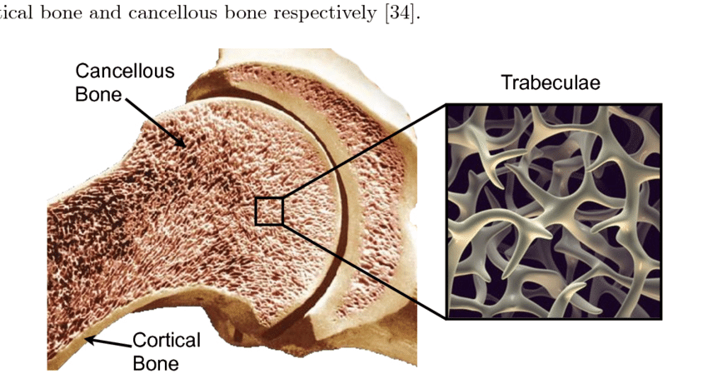
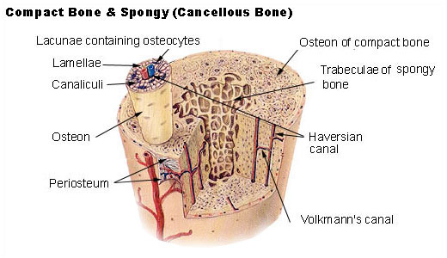

Slide 4
Lecture 7
What type of bone surrounds the medullary cavity of a long bone
Name 2 long bones
Parathyroid hormone in the body increases resorption of bone. It can be activated by low calcium levels.
What cells within the bone are activated in order to resorb more bone?
What mineral within the bone is broken down and primarily responsible for increasing calcium levels in the blood?
When a person increases their exercise, bone strength typically increases. What cells are involved in this process, and describe the mechanism of action.
Notes:
1. Cortical bone – hard on the outside
2. humerus, femur
3.a.. Osteoclasts are involved in resorbing bone
3.b. calcium hydroxypaptite
4. Osteocyte senses mechanical load -> stimulates osteoclasts to resorb bone (~2wk) -> stimulates osteoblast to line down resorption cavity (~4mo)

Slide 5
Lecture 7
When women undergo menopause, estrogen levels will decrease, resulting in bone breakdown. This is usually the underlying cause of post-menopausal osteoporosis. As a result, a type of drug called ‘bisphosphonates’ are given to these patients (can be given as a depot injection such as zoledronic acid). This has significantly reduced the incidence of osteoporosis within this cohort. The mechanism of action of this drug tends to involve ‘poisoning’ or killing off a certain cell within the bone. What cell would this be?
Watch the following video: https://www.youtube.com/watch?v=X8PTQtvkySs
In this video, ‘britney spears’ formed a dent in the baby’s head – this is called the ‘soft spot’, where bones of the skull are joined together. What type of joint is this?
Where else would you find this type of joint?
Joshua is a patient diagnosed with Marfan syndrome. What effect would such a disorder have on his joints?
Notes:
Bisphosphonates work by poisoning the osteoclasts
Women get osteoporosis b/c estrogen normally suppresses osteoclast, so now increased osteoclast activity -> increased bone resorption
Skull sutures are fibrous joints, you’d also find it in an ankle syndesmosis
Marfans syndrome is an abnormal collagen disease – causes hypermobility

Slide 6
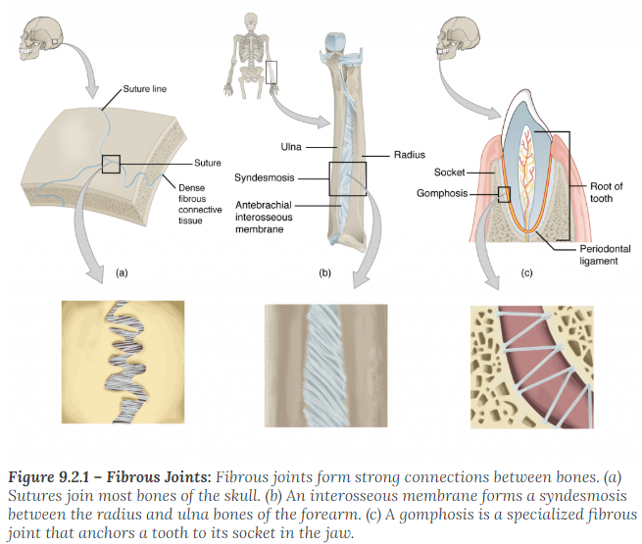

Slide 7
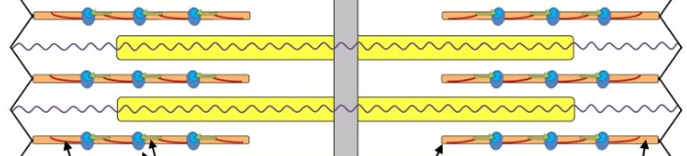
Lecture 8
When looking at something far away or something dark, your pupils will expand (dilate) – this occurs under the action of muscles.
What type of muscle fibre is involved in this activity?
Does opening the pupils involve contraction or relaxation of the muscle fibres of the pupil?
When you see something that is a threat (e.g. a big bear), what cardiovascular effects do you expect?
In the following figure, label the myosin and actin filaments:
Notes:
Accomodation to light:
Ciliary muscles (a circular muscle in your eye) is involved in the diameter of your pupil
Contraction will shorten the fibres, bringing them closer together, resulting in a smaller pupil; thus openin the pupil is a relaxation of the fibres
Big bear threat – increased SNS activity, fight/flight response -> sweating, lungs open up, heart rate and BP go up

Slide 8
Lecture 8
Describe the process of the crossbridge cycle in skeletal muscle sarcomeres
Type I muscle fibres are considered ‘red’ fibres because they have more myoglobin (thus increased oxygen binding capacity), whereas type II muscle fibres are considered ‘white’ because of a lack thereof. Given the respective functions of type I and type II fibres, which type of fibre would you expect to have more mitochondria?
Which muscle group provides an antagonistic function to that of the biceps brachii?
Notes:
Cross-bridge cycling:
Activation of the Neuromuscular junction results in Ca2+ release down t-tubules
Ca2+ binds to tropomyosin (which is blocking binding sites for myosin ON the actin)
Tropomyosin gets out of the way, allowing cross-bridge formation to occur between myosin (thick filament) and actin (thin filament)
Once bound, conformational change causes the movement of the actin filments closer together (myosin head rotates) – this processes uses up ATP into ADP
ATP needs to bind and replace the ADP to allow the release of the crossbridge
If the crossbridge isn’t released (not enough ATP to do so), then your fibres are stuck in position -> you get rigor mortis
Type 1: ‘red’ slow twitch fibres – aertobic metabolism, so needs more O2 to generate ATP, therefore has more mitochondria
Type 2 ‘fast twitch, less myoglobin, anaerobic,
Triceps brachii

Slide 9
Lecture 8
The most common cause of sudden cardiac death in young, healthy, athletic individuals is known as ‘hypertrophic obstructive cardiomyopathy’ or HOCM. This is a genetic disorder which causes the heart muscle (thus ‘cardio-‘) to become more bulky, allowing development of arrhythmias and possible obstructing outflow of blood from the left ventricle. Explain the meaning of ‘hypertrophy’. Give a physiological example of hypertrophy.
Notes:
Hypertrophy = increased SIZE PER CELL (vs. hyperplasia = MORE CELLS)
- You get muscle hypertrophy with exercise and training

Slide 10
Lecture 8
A student gave a presentation about muscle fibres, but he forgot which type of fibres his presentation slide was referring to. The slide notes that this muscle fibre ‘can operate anaerobically and forms ATP through the process of glycolysis, making it relatively inefficient’. What type of muscle fibres was he referring to? What is one way we can increase the proportion of this type of muscle fibre?
Notes:
Type 2 fast twitch fibres,
Can increased type 2 fibre proportions by not exercising / detraining
If you train for sprinting (vs marathon running) youd also have more type 2 fibres.

Slide 11
Lecture 8
A competitive weightlifter injured his pinky finger and decided that it would be a good time for him to give up weight-lifting. After 10 years, his friends (who he had not seen since his weight lifting days) noted that his skin was more elastic/stretchier and he seemed fatter. What process had occurred to his muscles over the last 10 years?
Notes:
Muscle ATROPHY

Slide 12
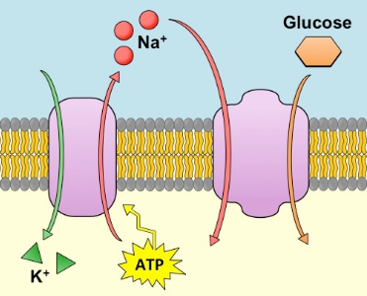
Lecture 9: Talking cells
Consider the following transport proteins – label them as either uniport, symport, or antiport

Slide 13
Lecture 9: Talking cells
Is the SGLT2 tranporter an active or a passive transport protein? How does it differ from Na-K-ATPase?
Which two ions have the greatest impact on the membrane potential?
Salbutamol (Ventolin) and insulin (used in diabetes) is clinically used when a patient presents with hyperkalemia (usually with a serum potassium > 5mM). This is because hyperkalemia can severely affect muscle function, including cardiac muscle, resulting in arrhythmias and potentially death. In order to reduce serum [K+], the rapid IV infusion of salbutamol or insulin is used to push K+ back intracellularly via the Na-K-ATPase pump. In a normal (not hyperkalemic) patient, how would IV infusion of salbutamol/insulin affect the membrane voltage of a cell?

Slide 14
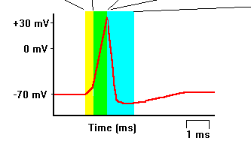
Lecture 9: Talking cells
In the following figure, for each colour, describe what happens to the sodium and potassium ion channels

Slide 15
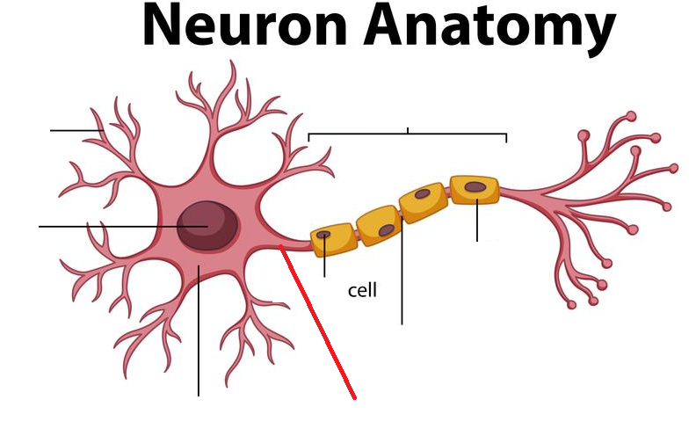
Lecture 9: Talking cells
Label the following components of a neuron:

Slide 16
Lecture 9: Talking cells
What modalities do sensory nerve fibres carry?
Which modalities are conducted fastest?
What cells are responsible for the formation of the nodes of Ranvier?
describe the process of neurotransmission across the synaptic cleft
Ethanol (Alcohol) as well as benzodiazepines are substances which potentiate the action of GABAergic neurotransmission (they act on GABA receptors on the post-synaptic cleft). In doing this, the function of GABA is increased. Would this result in the post-synaptic neurone firing more or less often?

Slide 17
Lecture 9: Talking cells
In computer science (machine learning), the deep neural network is a concept which involves computational and mathematical representation of neurons. In these networks, multiple ‘neurons’ will ‘fire’ onto a single ‘neuron’. When ‘firing’, they will give the target neuron a value between -1 and 1. For example:
if neurons A1, A2, A3 fire onto neuron B1, all they are doing is giving neuron B1 a number between -1 and 1 (e.g. -0.1, 0.3, 0.5).
Neuron B1 will take the average of the three values firing onto it (in this case, the average of -0.1, 0.3 and 0.5 is 0.35).
If the average of neuron B1 is > 0, it will pass on its value onto the next neuron in the chain. If it is <0, it will not pass on any value at all.
In the example of the neural network above:
Which neuron would be considered a ‘GABAergic’ neuron?
How does this model demonstrate a certain type of EPSP summation?
How does this model demonstrate the idea of the threshold potential?

Slide 18
Lecture 9: Talking cells
In myasthenia gravis, (autoimmune) antibodies target the nicotinic acetylcholine receptors at the neuromuscular junction (where the neuron triggers the muscle unit to activate). In this process, antibodies will destroy these post-synaptic neurotransmitters. What symptom/sign would you expect to see in the patient with MG?
Where does the CNS end and the PNS begin? Which sensory nerve fibres are considered part of the CNS, and which are part of the PNS?
What makes white matter ‘white’?

Slide 19
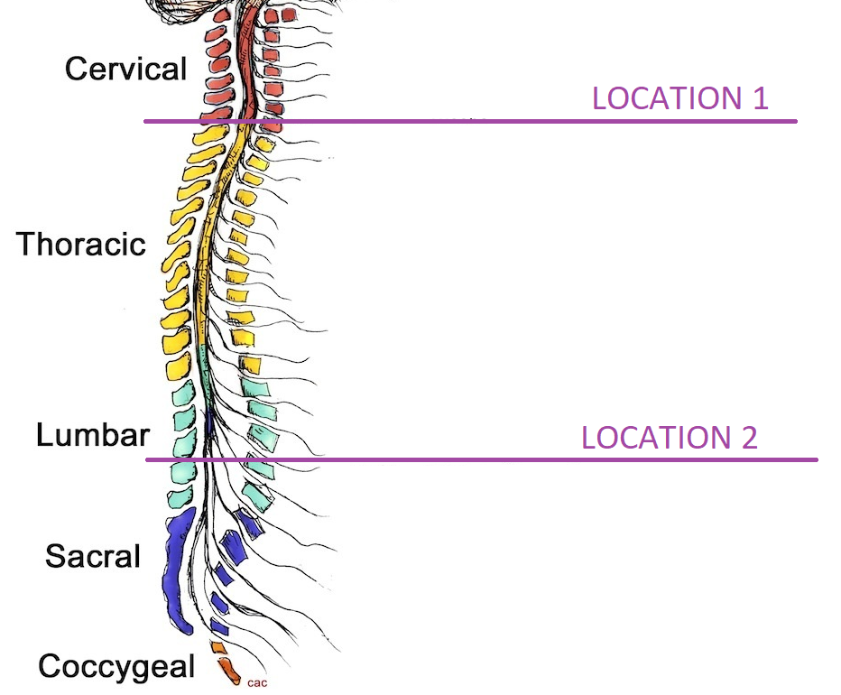
Lecture 9: Talking cells
Take the following figure
If the spinal cord were severed at location 1, would the sympathetic or parasympathetic system be affected more? Why?
If the spinal cord were severed at location 2, would the sympathetic or parasympathetic system be affected more? Why?

Slide 20
Lecture 9: Talking cells
A psychiatric anxiety disorder known as ‘performance anxiety’ (a subtype of social anxiety) causes an individual suffering from this disorder to experience extreme anxiety attacks when performing in public places or public speaking. This has dramatic effects on their capacity to function in the workplace, as they cannot give presentations or talk in front of large groups of people. One of the first line therapies for this is a beta blocker (propranolol).
What is the action of a beta agonist receptor blocker?
What is its effect on the cardiovascular system?
Why is propranolol generally contraindicated for severe asthmatics?

